Slide 1
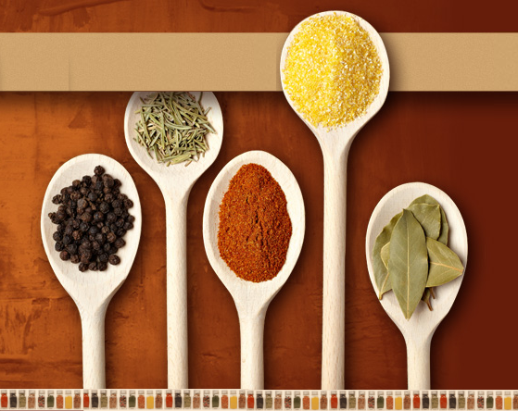

Old Mansion Foods
Delivering quality dry spice since 1877

Slide 2
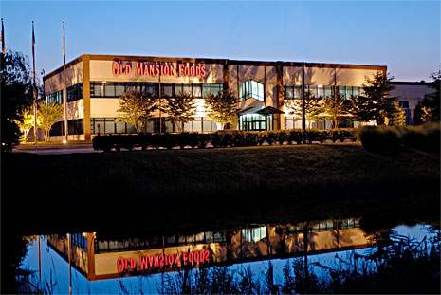
Deliverables
Custom wholesale sauces, ready to order
A new team of trained workers in production
Improved utilization of resources and space
Enhanced marketing and customer knowledge
Expanded use of online ordering availability

Slide 3
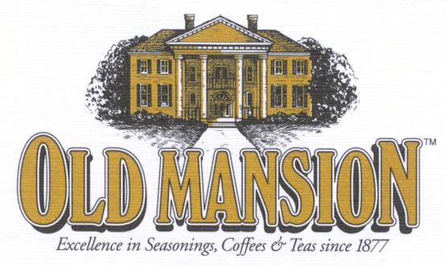
Business Need
Dry Spice machinery is the same as wet spice
Surplus machinery and warehouse space acquired
Wet spice revenue shows sustainable increases
Customers and vendor relationships are already established
Anticipate growing employees to match workload

Slide 4
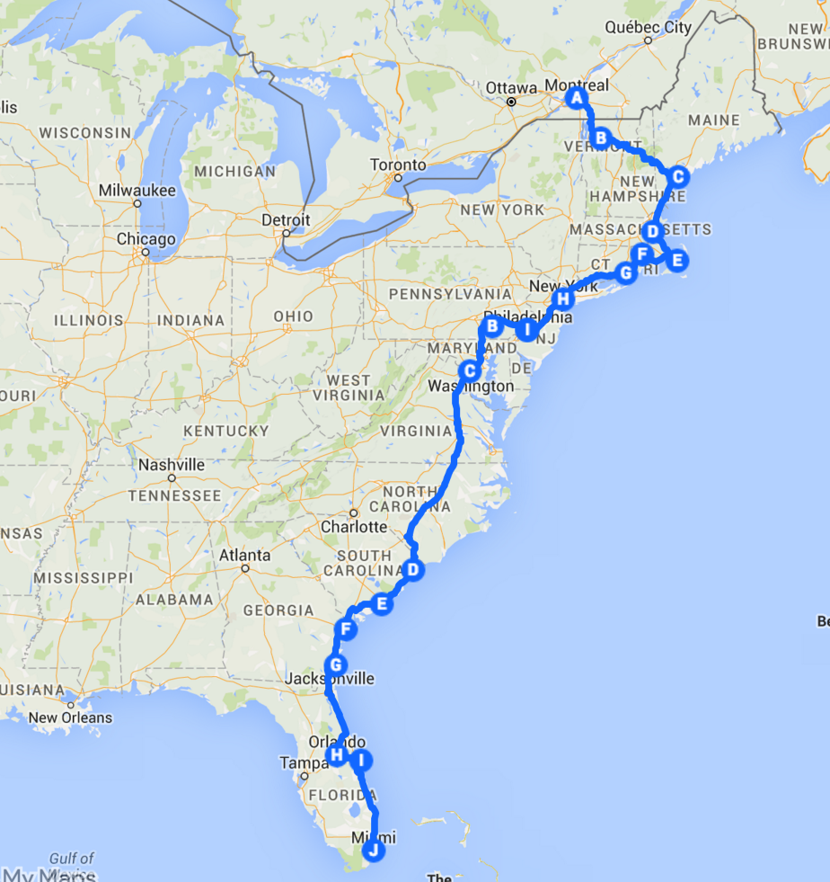
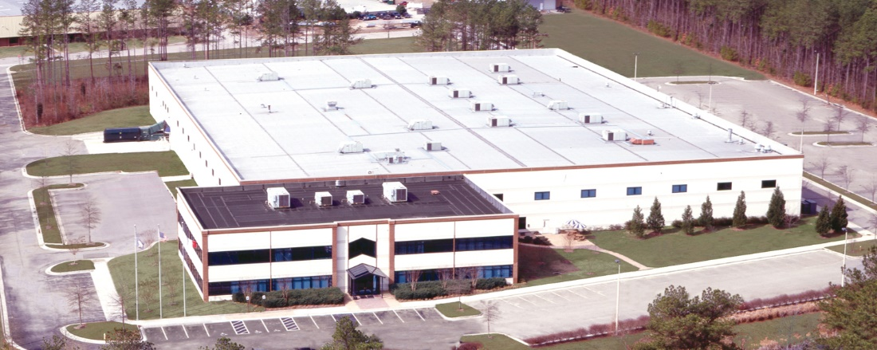
Location
Tactical location
Center of the east coast
Advantageous and strategic relationships with freight companies allowing significant discounts
No direct regional competition
Long standing relationships with wholesalers and local restaurants

Slide 5

SWOT
Strength in location, reputation, and untapped resources
Weakness in failure to predict market reception, no wet spice experience, and assumption that machinery is adequate
Opportunity in ownership of startup equipment, and a large local market with minimal competition
Threats include failure to obtain enough skilled labor, warehouse code inspection, and vendor performance

Slide 6
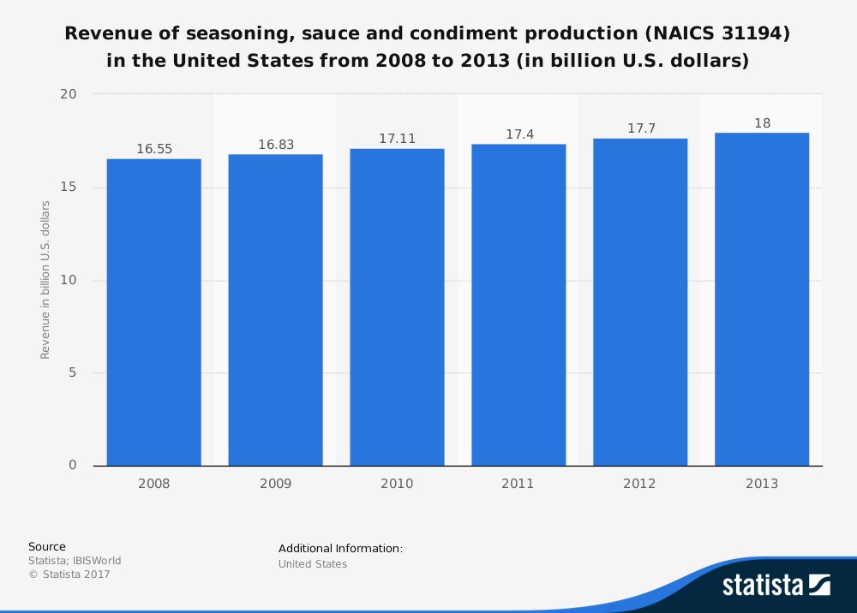
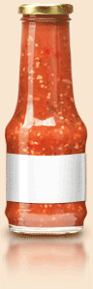

Profit Increase In Sauce Market

Slide 7


Scope
“Extend Old Mansion Food’s Reach into the Sauce Market”
This project is to create a fully staffed, sauce manufacturing facility that can produce, label, and bottle a custom line of sauces as well as private sauce orders, within one year.
Notes:
This project is to be completed in one year’s time within the budget of $400,000.

Slide 8
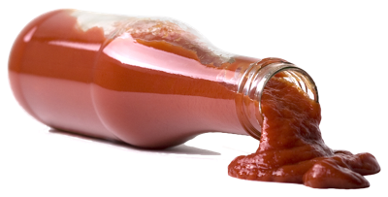
Risks
The spice industry is an agricultural business and is subject to supply and quality changes with each season. Weather conditions, political uncertainty and price instability can severely affect world supplies. Old Mansion’s highly trained Quality Control staff samples and analyzes all spices, blends, and soon to be sauces with a battery of laboratory tests to ensure they conform to our exacting requirements.
Top Three Risks
Failure to find skilled workers
Failure to gain traction in new market
Acts of God
Notes:
This project is to be completed in one year’s time within the budget of $400,000.

Slide 9

Project Estimates
Through extensive research we have found that the estimated cost of this project will be around $300,000 dollars with a project budget of $400,000. The project will start 3/8/2018 and end 3/8/2019 and the project activities will mostly work serially but some concurrency will be present.

Slide 10
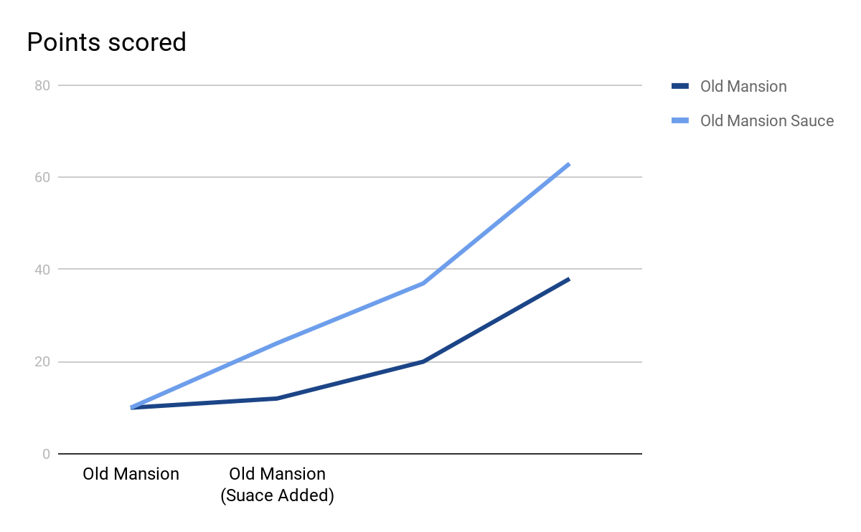
Profitability

Slide 11
Project Milestones
Project Milestones | Target Date
Project Start | 3/8/2018
Financial Planning | 3/9/2018
Operational Manufacturing Facility Prep | 5/20/2018
Equipment installation | 7/01/2018
Employment | 7/26/2018
Develop Sauces | 8/15/2018
Bottling and Labeling | 8/30/2018
Sales Contracts | 10/01/2018
Production | 11/26/2018
Distribution | 2/01/2019
Endproject | 3/8/2019

Slide 12
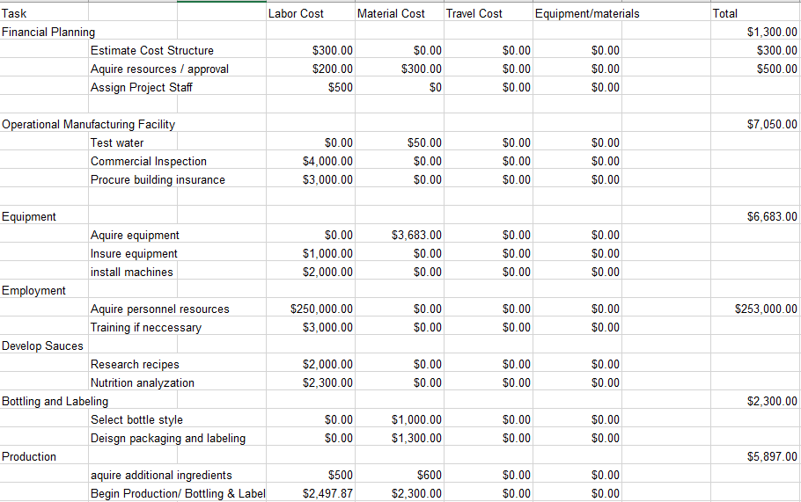
Project Budget

Slide 13
Personnel Resources
Personnel Resources Types | Quantity
Forklift Operators | 6 persons
Staff Trainers | 2 persons
Line Workers | 10 persons
Total | 18 persons

Slide 14
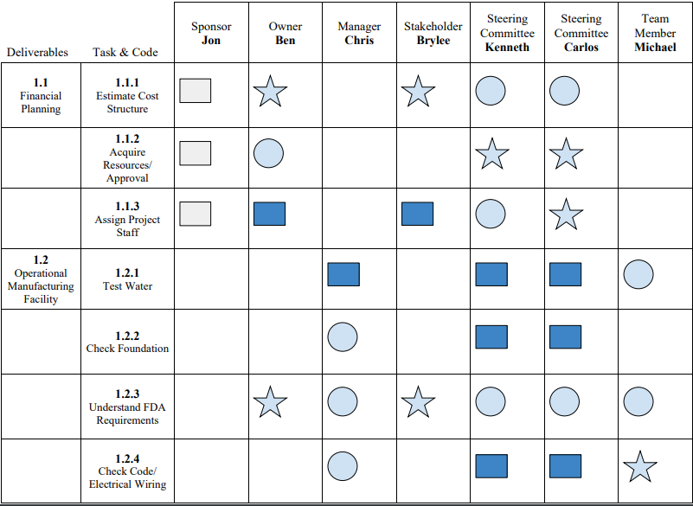
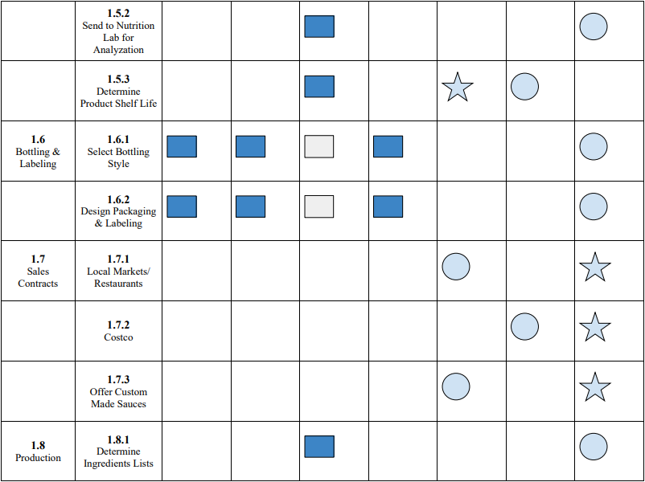

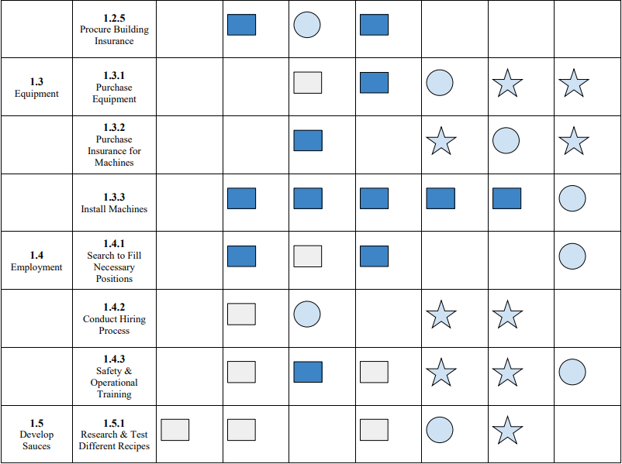
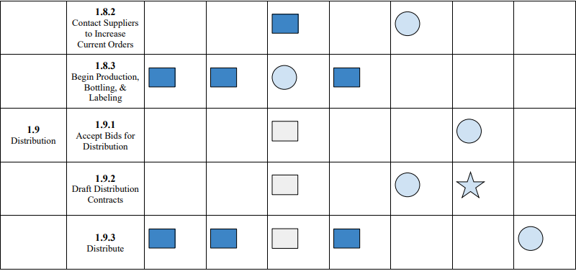
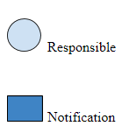
R
A
M
Notes:
This project is to be completed in one year’s time within the budget of $400,000.

Slide 15
Notes:
This project is to be completed in one year’s time within the budget of $400,000.

Slide 16
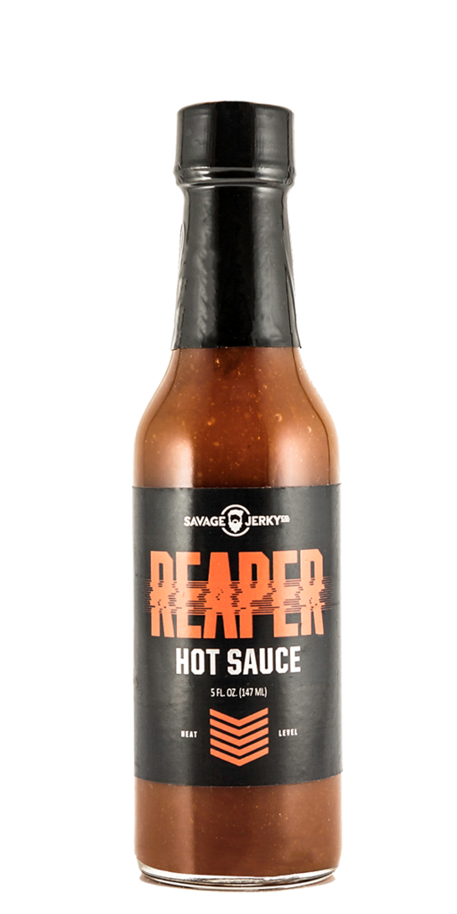
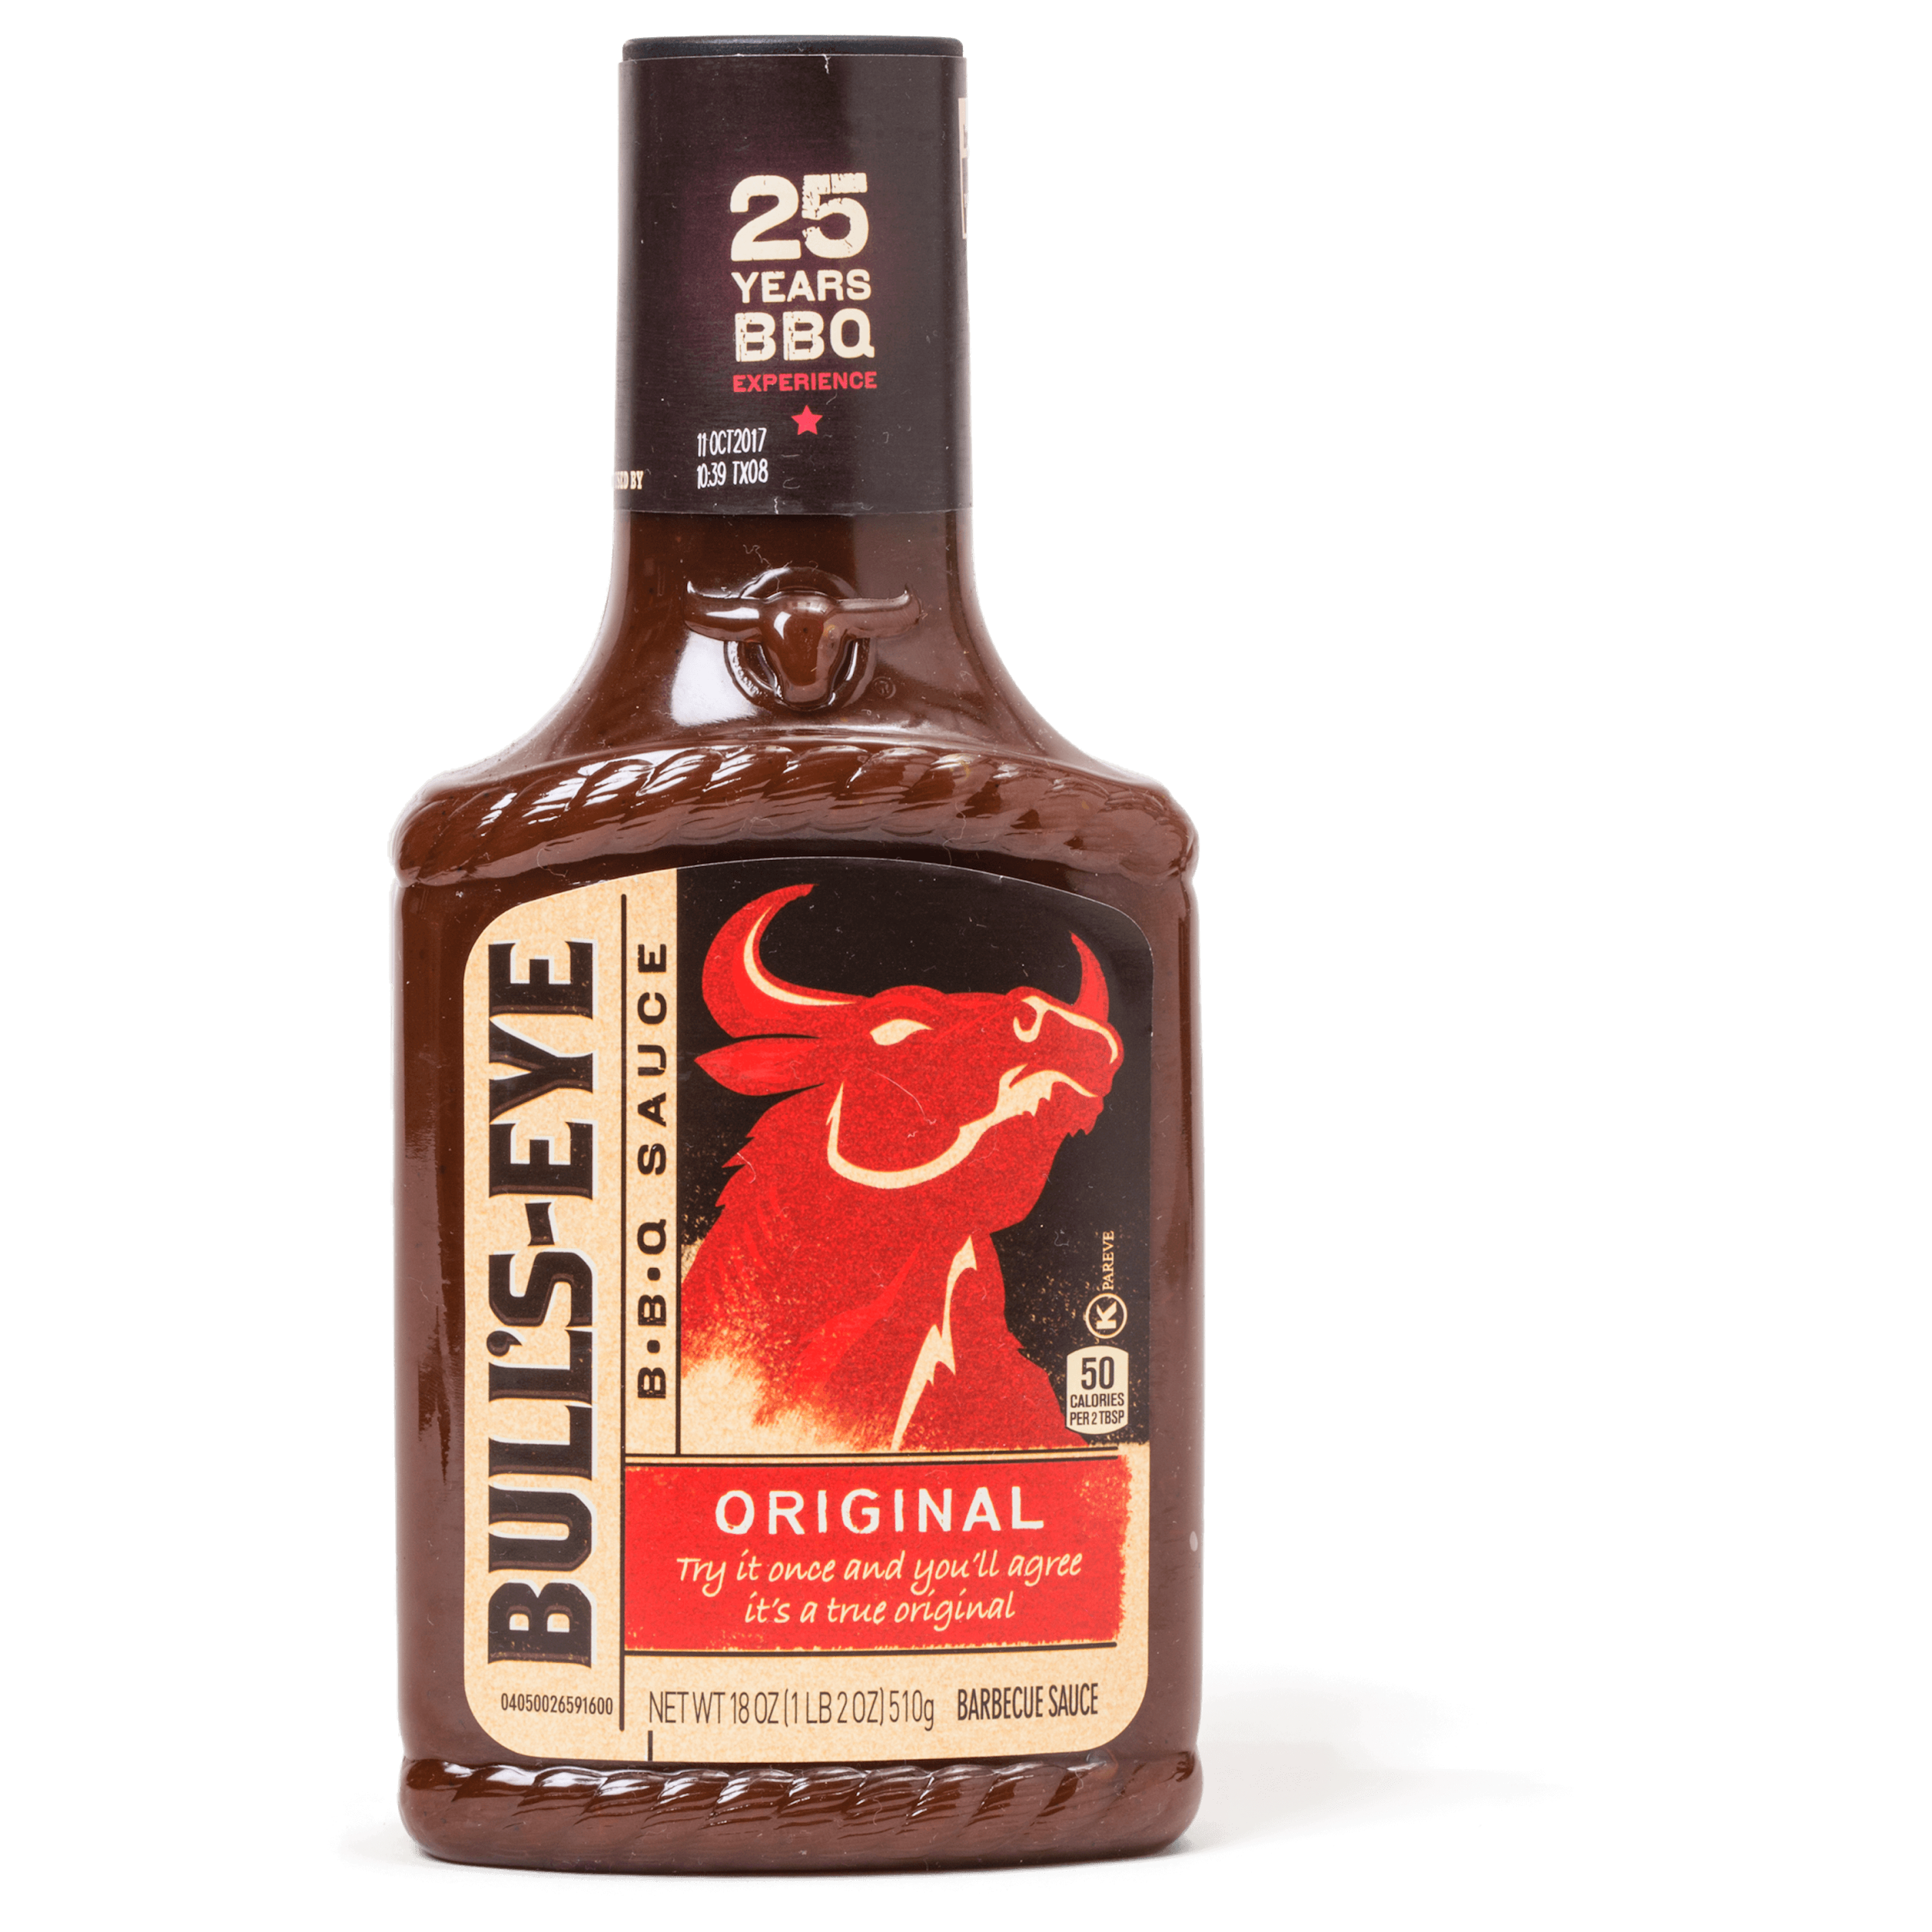
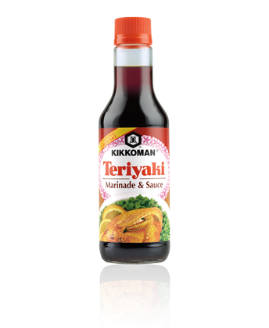
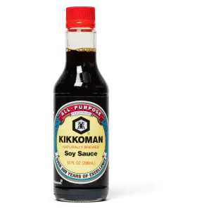
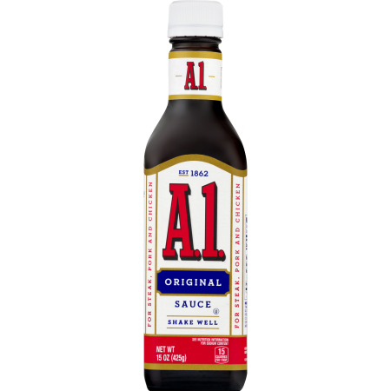
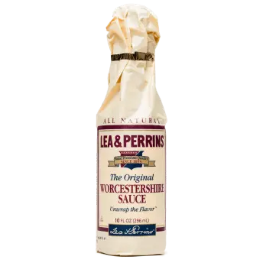
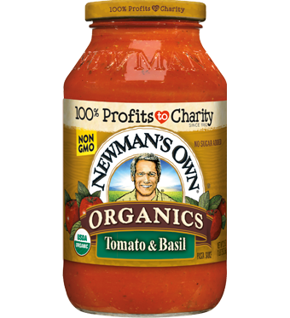
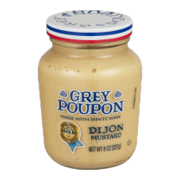
Ingredients
Hot sauce:
Various peppers, garlic, onion, salt, vegetable oil, water, vinegar
BBQ sauce:
Ketchup, water, apple cider vinegar, brown sugar, white sugar, black pepper, onion powder, ground mustard, lemon juice, Worcestershire sauce
Teriyaki:
Soy sauce, water, ground ginger, garlic powder, brown sugar, honey, cornstarch
Steak sauce:
Ketchup, Worcestershire sauce, brown sugar, hot pepper sauce, mustard, apple cider vinegar, salt, pepper
Soy sauce:
Fermented soybean paste, roasted wheat (grain), salt, water
Worcestershire sauce:
Barley malt vinegar, spirit vinegar, molasses, sugar, salt, anchovies, tamarind extract, onions, garlic, various spices (soy sauce, lemon, pickles, peppers)
Dijon mustard:
White wine, ground brown mustard seed, salt, turmeric, paprika, verjuice (juice made from unripe grapes)
Tomato sauce:
Olive oil, onion, bay leaf, oregano, garlic, salt, tomato paste, tomatoes

Slide 17
Measuring Success
Increased demand for product from current vendors and wholesalers.
Substantial new business from online private and custom markets.
… potential, unrealized profits estimated at $7.5 million.

